Slide 1
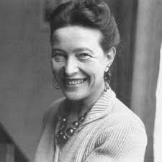
Simone de Beauvoir
Revolution and Reaction, 2023/24
Dr Maša Mrovlje

Slide 2
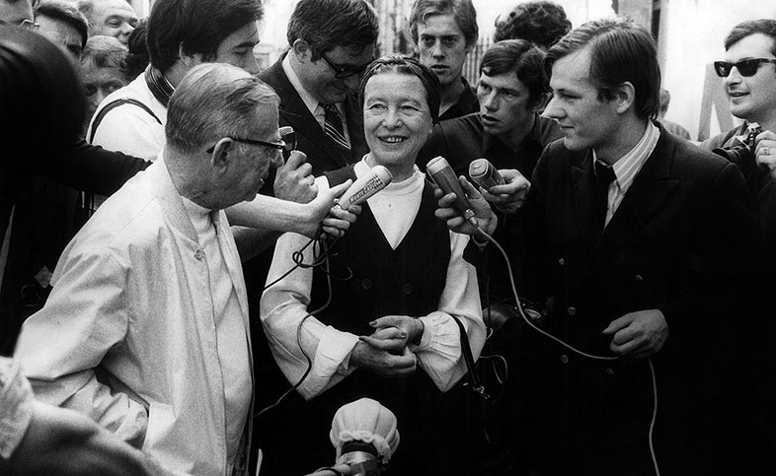
Who was Beauvoir?
Founder of modern feminism
An important representative of the twentieth-century French existentialism
A public or `engaged` intellectual

Slide 3
Lecture plan
Life and times
The Second Sex: main ideas
Oppressive situation of women
Political implications
Feminist praxis
Beauvoir’s legacy and influence
Literature

Slide 4


Life and times
Born in Paris in 1908, studies philosophy
Forms a life-long partnership with Sartre; they launch Les Temps Modernes in 1945
The publication of The Ethics of Ambiguity (1947) and The Second Sex (1949)

Slide 5
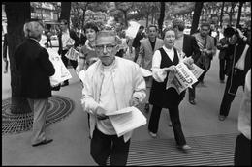
Life and times (cont.)
The height of her political engagement with the Algerian war
Beauvoir supports the Algerian cause of independence and writes in support of Djamila Boupacha

Slide 6

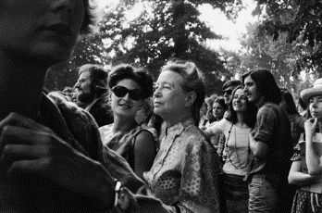
Life and times (cont.)
Later supports a number of feminist initiatives; also conducts a study of the society`s oppressive attitude towards the elderly
Dies in 1986.

Slide 7
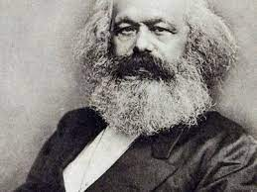
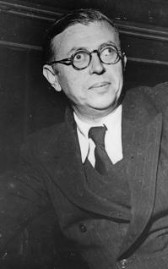
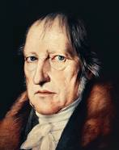
Theoretical influences
Existentialism: existence precedes essence
Marxism: the weight of situation
Hegel’s account of intersubjective recognition: self-other relations

Slide 8


Present relevance
Women still face various forms of social, economic and sexual oppression and exploitation
The overturning of Roe vs Wade
MeToo movement
Poor performance in persecuting the crime of rape
NiUnaMenos against femicide
Workplace inequality https://www.youtube.com/watch?v=40hhc0cjYyg

Slide 9
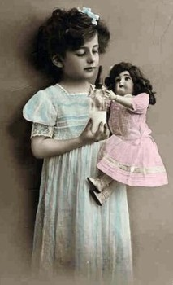

The Second Sex

Slide 10
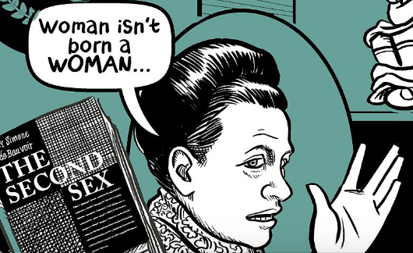
Existentialist feminism
“One is not born but rather becomes a woman.”
There is no eternal “feminine essence,” the category of woman is socially and politically constructed

Slide 11

1) Self-Other dynamics
Woman as the absolute Other
Woman is denied recognition as free subject
She is reduced to her immanence or facticity (for instance, a given body or her domestic role)

Slide 12

2) Oppressive situation of women
Notion of situation
Beauvoir’s focus on a plurality of women’s lived experience
Oppressive views about women are deeply structural

Slide 13
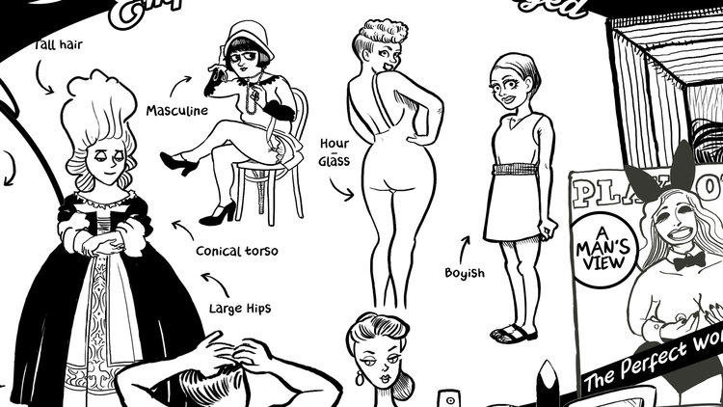
3) Body as situation
“Woman, like man, is her body; but her body is something other than herself.”
Women experience their bodies mostly as constraint
The process of ‘becoming flesh’
Feminine Beauty: A Social Construct? https://www.youtube.com/watch?v=xT6wjgssVK4.

Slide 14

4) Women’s complicity
Their situation conditions women to accept the roles determined for them by patriarchal ideology
Women complicit in their own oppression
Reduce their being to that of an object

Slide 15
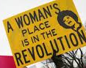
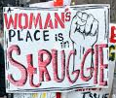
Political implications
Oppression is structural
Individual efforts are not enough– struggle for change requires collective political action
The desired goal of equality should not reduce women to men

Slide 16

Political implications (cont.)
A vision of feminism that discounts the determining importance of sexual difference and focuses on challenging women’s oppressive situation
Supports women’s struggle against patriarchy as a separate fight that cannot be reduced to class struggle

Slide 17

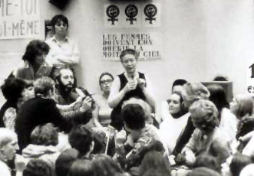
Feminist politics
Writes in support of Djamila Boupacha: rape as a crime of war
Campaigns for free contraception and the right to abortion
Fights against everyday sexism, for battered women and to challenge continued relations of inequality at the workplace
Insists on the need to change the way political power is exercised

Slide 18


Legacy and influence
One is not born a woman, at the root of second-wave feminism
Judith Butler: performativity of gender
Parallels to Fanon’s analysis of black embodiment; links to intersectionality
Critique: primacy of the heterosexual bond
Alternative conception of humanism attentive to our different ways of being situated in the world

Slide 19
Summary
Beauvoir’s focus on lived experience to uncover women’s oppressive situation
Category of woman is socially and politically constructed
Woman as the absolute Other
Women’s embodiment as situation
Oppression is structural
Struggle for change requires collective action

